Slide 1
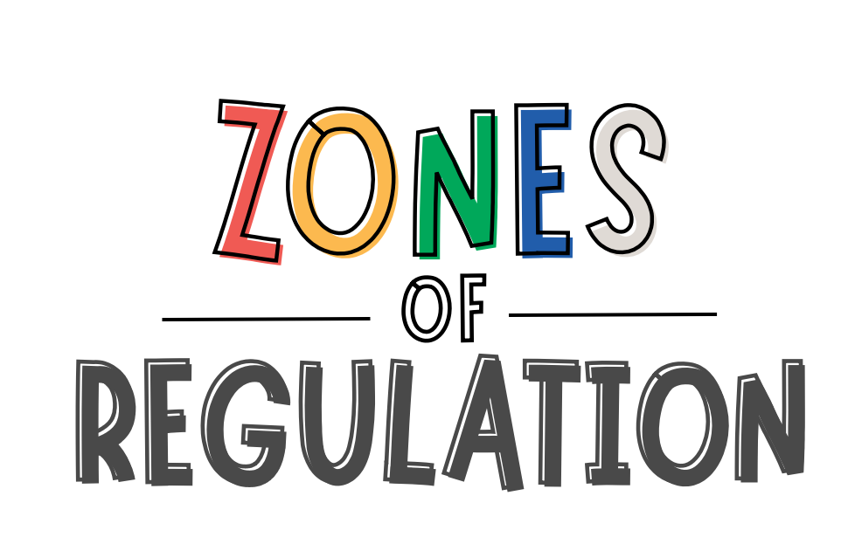
A Presentation for Parents and Carers Saima Rahman Assistant Educational Psychologist Saima.Rahman@salford.gov.uk

Slide 3
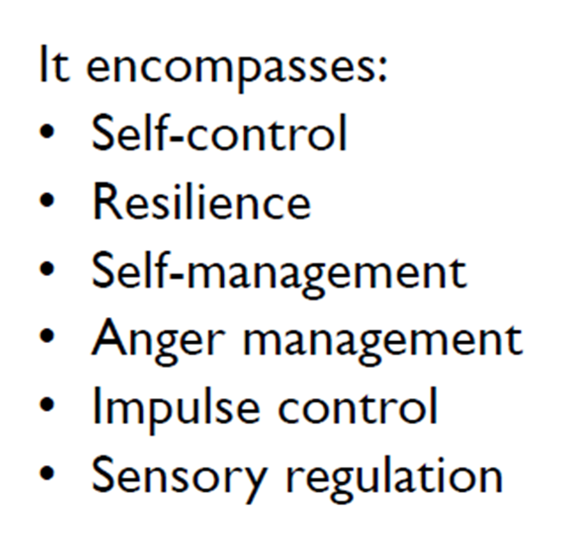
Definition of self regulation
“It is defined as the best state of alertness of both the body and emotions for the specific situation.
For example, when a student plays on the playground or in a competitive game, it is beneficial to have a higher state of alertness. However, that same state would not be appropriate in the library.”
(Leah Kupers).
Notes:
We’re thinking about the range of emotions that we feel as human beings and when each emotion is appropriate and how we can manage those emotions across situations.

Slide 5
What does Zones Regulation teach?
Vocabulary of emotion terms
How to recognise their own emotions
How to detect the emotions of others (read others’ facial expressions).
what may trigger certain emotions
How others may interpret their behaviour
Problem solving skills

Slide 6
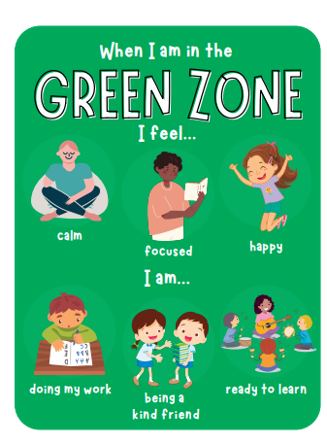
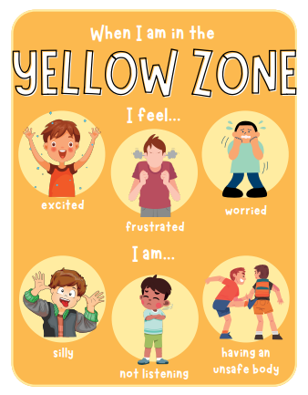
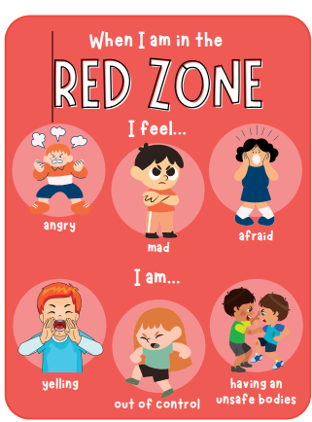
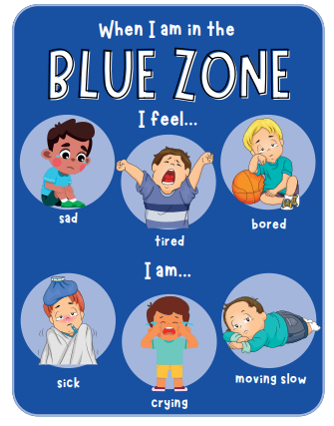
Regulated state of alertness
Heightened state of alertness but you still have some control
Heightened state of alertness and out of control
Low state of alertness, brain or body is slowly

Slide 7
Key points
There is no ‘bad’ Zone
Everyone experiences all of the different zones at different times and in different circumstances
We can’t change the way children feel BUT we can help them manage their feeling/ states and behaviours. “It’s ok to be angry, but its not ok to hit”.
You can be in more than one zone at a time e.g., sad and angry (blue and red),

Slide 8
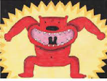
Key points
If your child is confidently using words to describe their emotions, they don’t need to revert to Zones language, however its useful for them to know the strategy groups that will help them.
e.g., sick or tired = blue zone strategies
If your child is in the red zone:
Limit verbal language. This is not a teachable moment
Discuss the use of tools when child is regulated
Plan for if/when child is in red zone “wonder if this strategy would help…?”

Slide 12
Notes:
This is just something to consider when working with your child on their tools. This is inner coach vs. inner critic and here you’re supporting your child with their thinking which can be a tool that they use. Inner coaches help us use positive self-talk to give us the courage and strength to get through stressful situations. They can be supported to think about difficult times that they might need their inner coach for, and what that inner coach might say to them.
Inner critics use negative self-talk that get us nowhere. It puts defeating thoughts in your head. Children can think about difficult times that their inner critic gets to them and where the inner critic makes a situation worse and what it might say to do so.
Children to be reminded that they are in control of who they listen to – inner coach or inner critic. Can use inner coach to defeat inner critic by telling it:

Slide 13
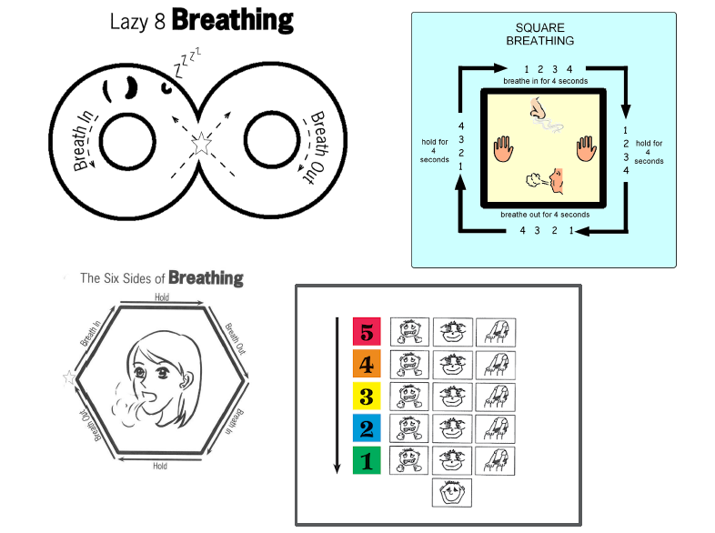

Slide 16
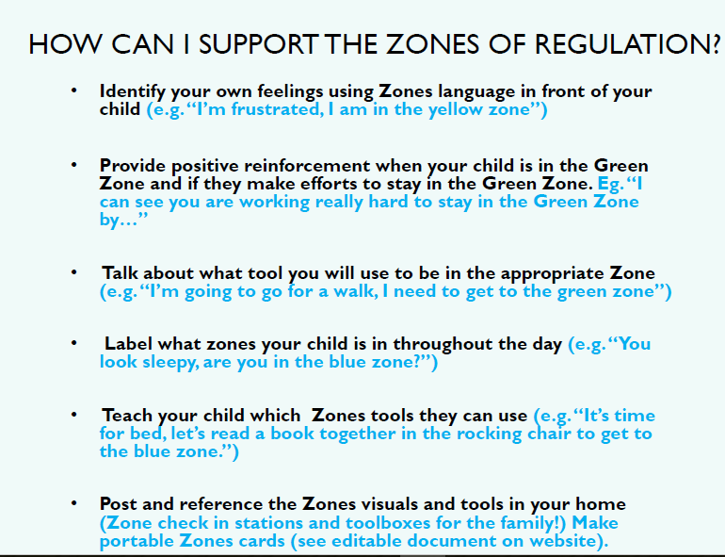

Slide 17
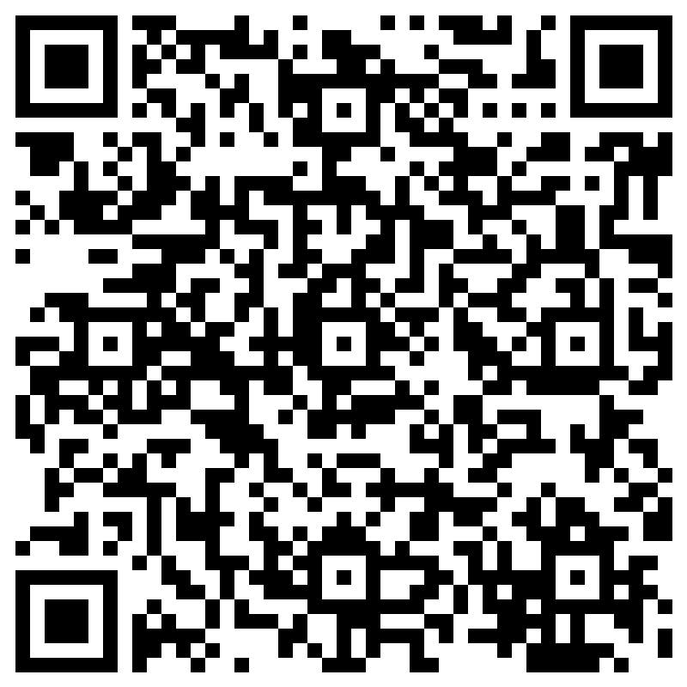
Thank you! Any questions?
Please fill out our quick evaluation form

